Slide 1
Restaurant Ranking Application
By :
Zubair sagheer (BSCS13038)
Maham Jhonsons (BSCS13052)
Hamza Javed (BSCS13061)
AAzaz ul haq(BSCS13068)
Zuhaib Quraishi (BSCS13076)

Slide 2
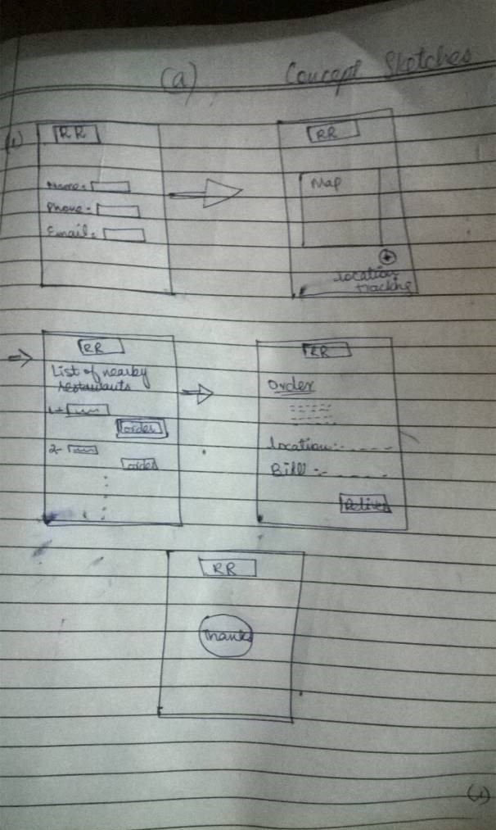
Concept Sketches:
First step : login detail
Second step: show you the map (you can use the map to search restaurant )
Third step : Nearby restaurant by on your location
Fourth step : Order

Slide 3
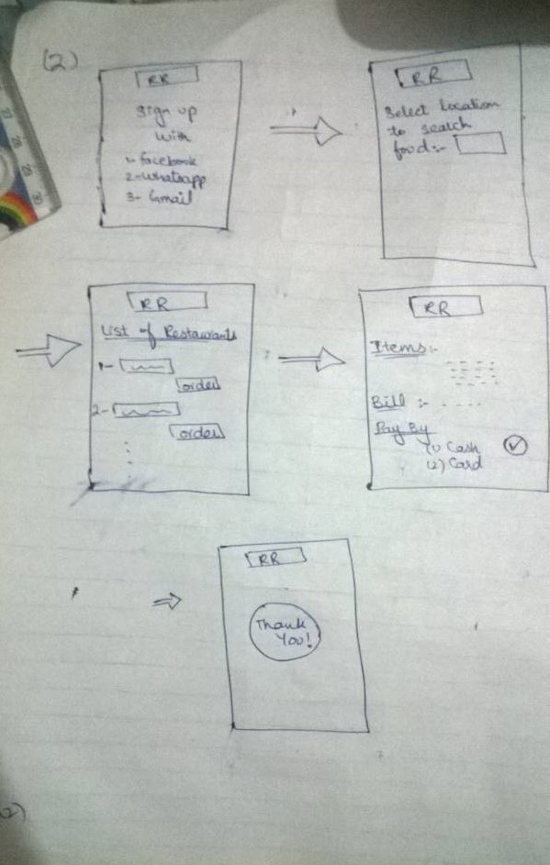
Concept Sketches (2)
First step : login detail
Second step: Select location
Third step : List of restaurant
Fourth step : Deals (order )

Slide 4
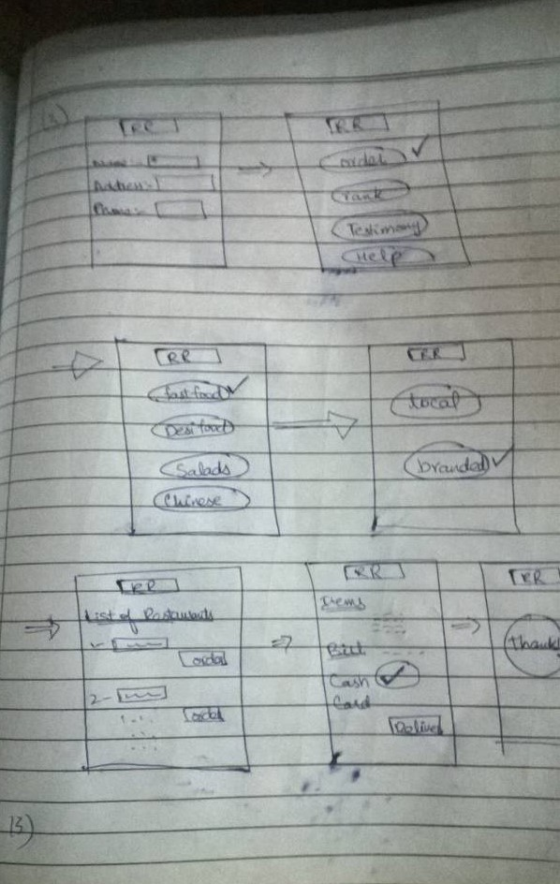
Concept Sketches (3)
First step : login detail
Second step: Select location
Third step : List of restaurant
Fourth step : Deals (order )

Slide 5
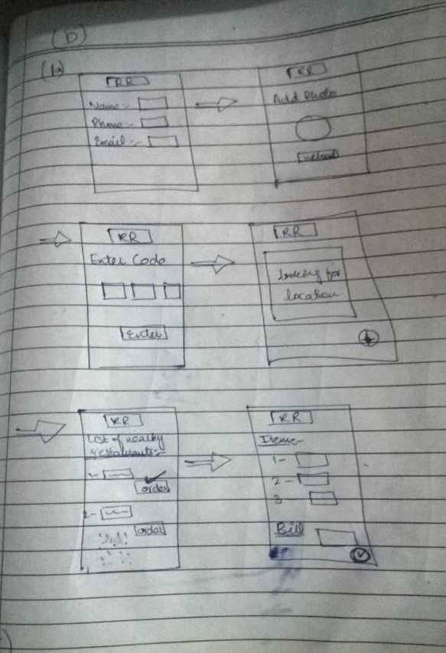
UI Sketches
First step : login detail
Second step: Add photo
Third step : Enter code
Fourth step : looking for location
Fifth step: Select food and order

Slide 6
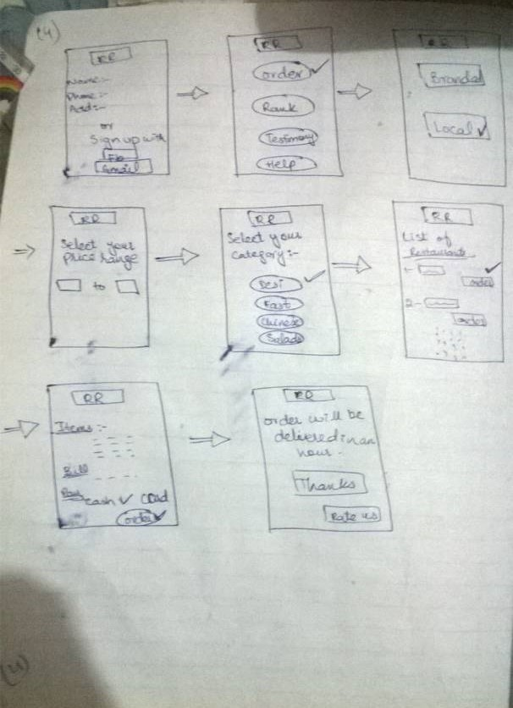
UI Sketches 2
First step : login detail
Second step: Order ,Rank ..
Third step : Branded ,Local
Fourth step : Select your price range
Fifth step: Select price range
Fifth step: List of restaurant
Sixth step : select and order

Slide 7
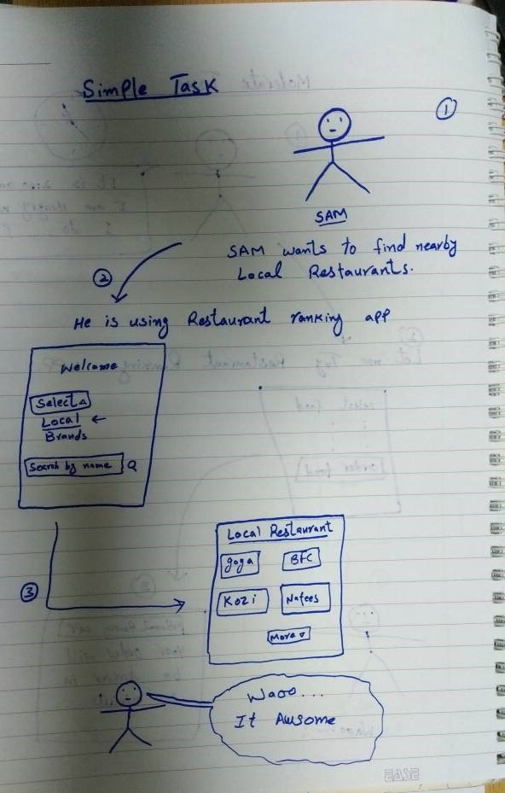
UI Storyboards:
Simple task :
Sam wants to use nearby restaurant
He use restaurant ranking app

Slide 8
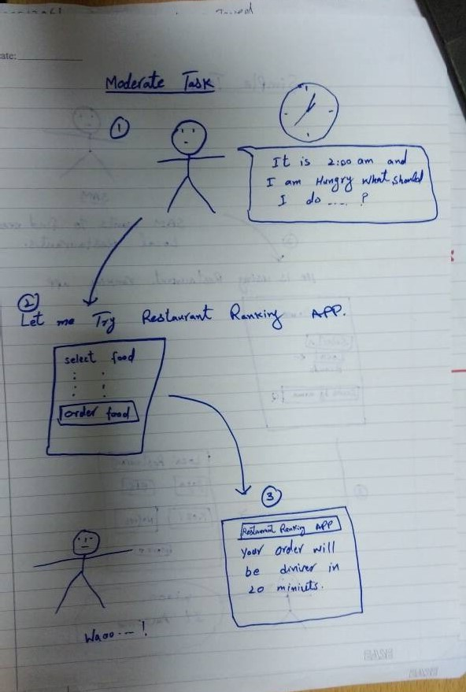
UI Storyboards:
Moderate task:
The time is 2 am
He feels hungry
He used restaurant ranking app
He ordered food
Then he received his order

Slide 9
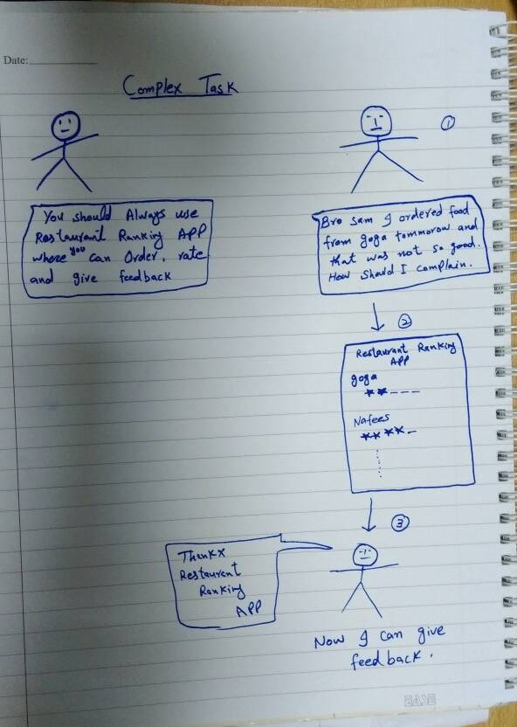
UI Storyboards:
Complex task :
He chats with his friend
He share bad experience about one restaurant and asked how to review
Then he gave one star review to that restaurant

Slide 10
Testing Procedures
User like events
User dislike event

